Slide 1
Password Managers
Michael Alfano && Jack Padalino

Slide 2
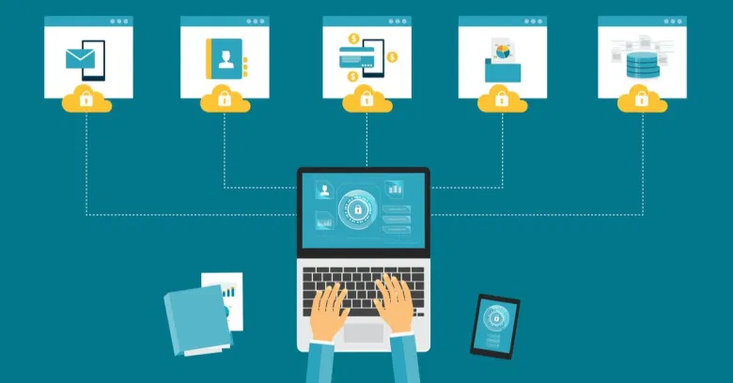
Password managers: Security and convenience
Store all your passwords for all your sites and accounts in one place
Can access your account from any device
Account syncs every time you add a new password

Slide 3
1Password
LastPass
01
03
Dashlane
Bitwarden
02
04
RoboForm
EnPass
05
06
Premium $36/year, unlimited passwords
$36/year, free version, unlimited passwords
$60/year, free version, unlimited passwords
$10/year, free version, unlimited passwords
$24/year,
$12/year

Slide 4
Should we trust these managers?
Master password is 256 bit encrypted. Considered to be essentially unbreakable
Popular managers are open source (available on GitHub)
“Zero knowledge” policies

Slide 5
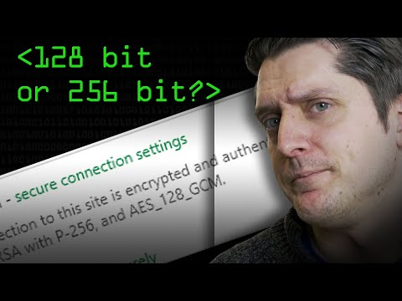
What does 256 bit mean?

Slide 6
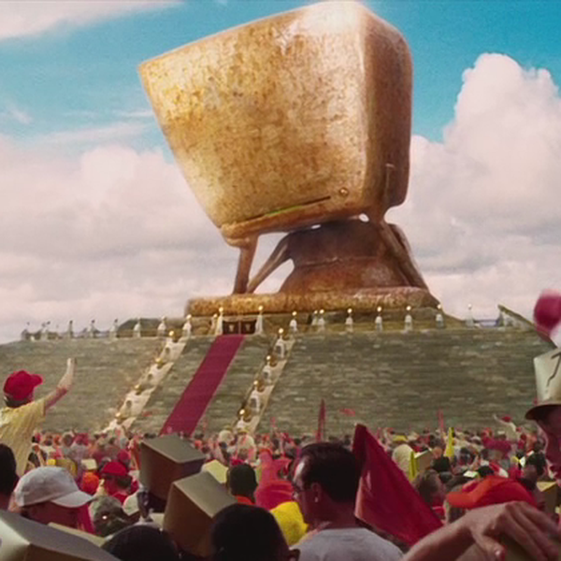
Brute force attacking 256 bit encryption...
Computing Power | Time to brute force break 256 bit
High end PC | 27,337,893,038,406,611,​194,430,009,​974,922,940,​323,611,067,​429,756,962,​487,493,203 years. 27 trillion trillion trillion trillion trillion years
Fastest supercomputers | 27,337,893,038,​406,611,194,​430,009,974,​922,940,323,​611,067,429,​756,962,487 years. 27,337,893 trillion trillion trillion trillion years
2 billion high end PCs | 13,668,946,​519,203,305,​597,215,004,​987,461,470,​161,805,533,​714,878,481 years 13,689 trillion trillion trillion trillion years

Slide 7
But...are they safe?
Hacking user information should therefore be impossible! However...

Slide 8
The ugly truth- Password managers aren’t perfect!
2015
2016
2014
2017
LastPass: Cyber criminals stole email addresses, password reminders, and authentication hashes.
Flaws discovered in 9 password management apps developed for Android
Keeper: Exposed passwords to unreliable web pages.
LastPass: Browser plug-in vulnerabilities discovered
RoboForm: Critical vulnerability found that could allow attackers to obtain stored login credentials and credit card payment details.

Slide 9
PROBLEM VS. POSSIBLE SOLUTION
Problem
Possible Solution
Password managers might not be 100% safe
Replicate the functionality of a password manager locally

Slide 10
Generate and Safely Store Secure Passwords
Secure Password Generators
Storing Passwords
Version 1: Passwords only (linked)
Version 2: Websites, Passwords, & recovery (linked)
Passwords can be stored using password protected PDF, text document, or disk image (video linked)

Slide 11
DRAWBACKS
No Cloud-Sync Option
Not as user-friendly
Passwords only saved locally on device, may be more secure, but is less convenient
Setup and maintenance requires above average tech skills and time to maintain

Slide 12
How can we apply this in the classroom?

Slide 13
Unit plan: Algorithms, passwords, encryption
Students build a password generator while learning about concepts like algorithms, encryption, and algorithm efficiency
Link to unit plan folder

